Slide 1
Kubernetes Emergency? PowerShell to the Rescue!
AzureCLI + ConvertFrom-Json = AKS the way you already know
Amanda Debler - @texmandie

Slide 2
Orientation
Who is this person?
Amanda Debler
@texmandie
https://mandie.net

Slide 3
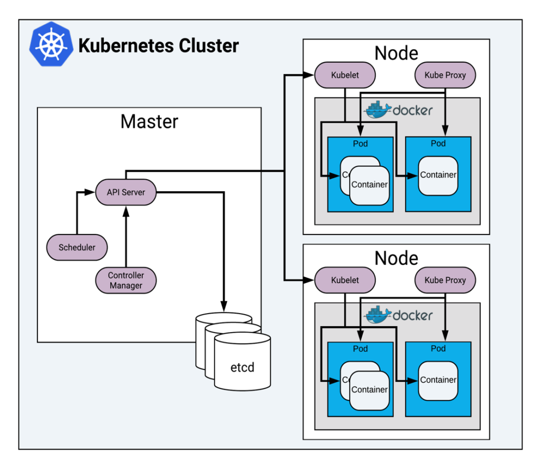

What is Kubernetes? AKS?
@texmandie

Slide 4
AKS is "managed Kubernetes" - but we still have some managing to do
@texmandie

Slide 5
Azure CLI vs Azure PowerShell for AKS
X Set-AzAks –KubernetesVersion does not work yet
@texmandie

Slide 6
There is no Kubernetes module.
@texmandie

Slide 7
…so why are we still messing around with PowerShell?
@texmandie

Slide 8
The Emergency - Runc and CVE-2019-5736
The containerized nightmare - escape!
A quick fix to Docker, but how to update all our clusters and check them?
@texmandie

Slide 9
Fixing It with AZURE CLI AND ConvertFrom-Json
Get point release for each major version
Tell AKS to update cluster to desired version
Check each node in each cluster for corrected Docker runtime version
@texmandie

Slide 10
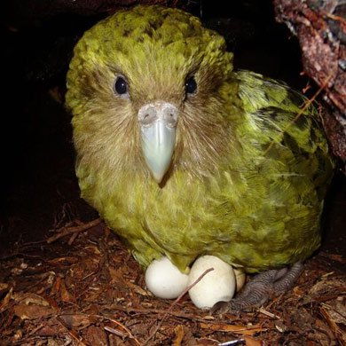

Save The Party Parrots!
@texmandie

